Slide 1



London Airbnb Customer Satisfaction
Austin Eoriatti, Dominic O’Brien, Rylie McDermott, and Christian Kleronomos

Slide 2
Executive Summary
Problem: What are the factors that affect an Airbnb guest’s overall satisfaction with their stay? This analysis is beneficial to Airbnb owners to help them understand how to make their Airbnb better for customers while maximizing profits.
Data Source: Airbnb Prices in European Cities from Kaggle.
Methods: Multi-linear regression models, collinearity, and residual plots.
Measures: Variables, Dummy Variable, P Values, Correlation
Conclusion: In conclusion, we started with 6 variables, but later determined price per night was not a significant variable due to it’s p-values being greater than our alpha of 0.05. After removing this variable, we arrived at a more parsimonious model. This model only includes the variables we deemed to be significant: cleanliness ratings, person capacity, distance from downtown, privacy status, and number of bedrooms. Our parsimonious model ended up with a low coefficient of determination, where only 0.5672 or 56.72% of the variability in the guest satisfaction is explained by the independent variables.

Slide 3
Problem Statement – What Are We Trying To Solve
English Problem Statement:
What affects the guest’s overall satisfaction of staying at an Airbnb in London on a weekend?
Airbnb's Analytics Problem Statement:
What factors have the most influence in predicting the overall satisfaction of staying at an Airbnb on the weekend in London?
What factors are statistically significant on overall guest satisfaction?
Further Questions:
What factors are not statistically significant on overall guest satisfaction?

Slide 4
Problem Statement: How Will We Solve it?
Dependent Variable: Customer satisfaction
Independent Variables: Price per night, Person Capacity, Cleanliness Rating, Distances from downtown, Bedrooms, Privacy status.
Strategy: Develop a multi variable regression model that will allow us to develop residual plots, collinearity graphs, analyze P-values, and a variable’s correlation to eventually form a conclusion.

Slide 5

Problem Statement - Assumptions
We are using a 0.05 Alpha
Our variables only come from Kaggle.
The only variables used in our analysis being: Price per night, Person Capacity, Cleanliness Rating, Distances from downtown, Bedrooms, Privacy status.
Our independent variables are truly independent.
The variance of error remains constant amongst all independent variables.
Outliers have been identified and addressed appropriately
The data used from this analysis was retrieved from a reliable public data source.
Variables that contain customer given scores were answered truthfully and accurately by customers.

Slide 6
Data
5,380 rows
5,379 rows of data
1 row of labels
19 columns
1 row assigning a number to the data
18 variables describing Airbnb's.
We used 7 variables
6 independent variables
1 dependent variable

Slide 7
Data Continued
Multivariable Regression
Dependent variable: Guest overall satisfaction rate
Independent variables: Price per night, person capacity, cleanliness rating, distance from downtown, bedrooms, privacy status
Hypothesis
Alpha = 0.05
Ho = The coefficients of the independent variables equal zero and do not have an impact on the overall satisfaction of an Airbnb guest.
Ha = The coefficients of the independent variables do not equal zero and have an impact on the overall satisfaction of an Airbnb guest.

Slide 8
Variable Definitions
Rate per Night – The cost in British Pounds of staying in the Airbnb for one night.
Person Capacity – Person capacity refers to the number of occupants allowed to stay in the Airbnb.
Cleanliness rating - The average of all guest ratings of cleanliness given by people who had previously stayed in the Airbnb. The ranking is between 1 and 10.
Distance from Downtown – The distance from downtown is a measure in kilometers (Km) that shows the relative distance from the Airbnb to the London Town Center.
Bedrooms - Bedrooms are the total amount of bedrooms within the Airbnb that can be rented out.
Privacy Status – Privacy status shows if the room is shared or private. It is 0 if the room is shared and 1 if the room is private.
Overall Guest Satisfaction - The overall guest satisfaction is the average rating of how satisfied all guests were with their stay in the Airbnb. This is on a scale of 1 to 100.

Slide 9
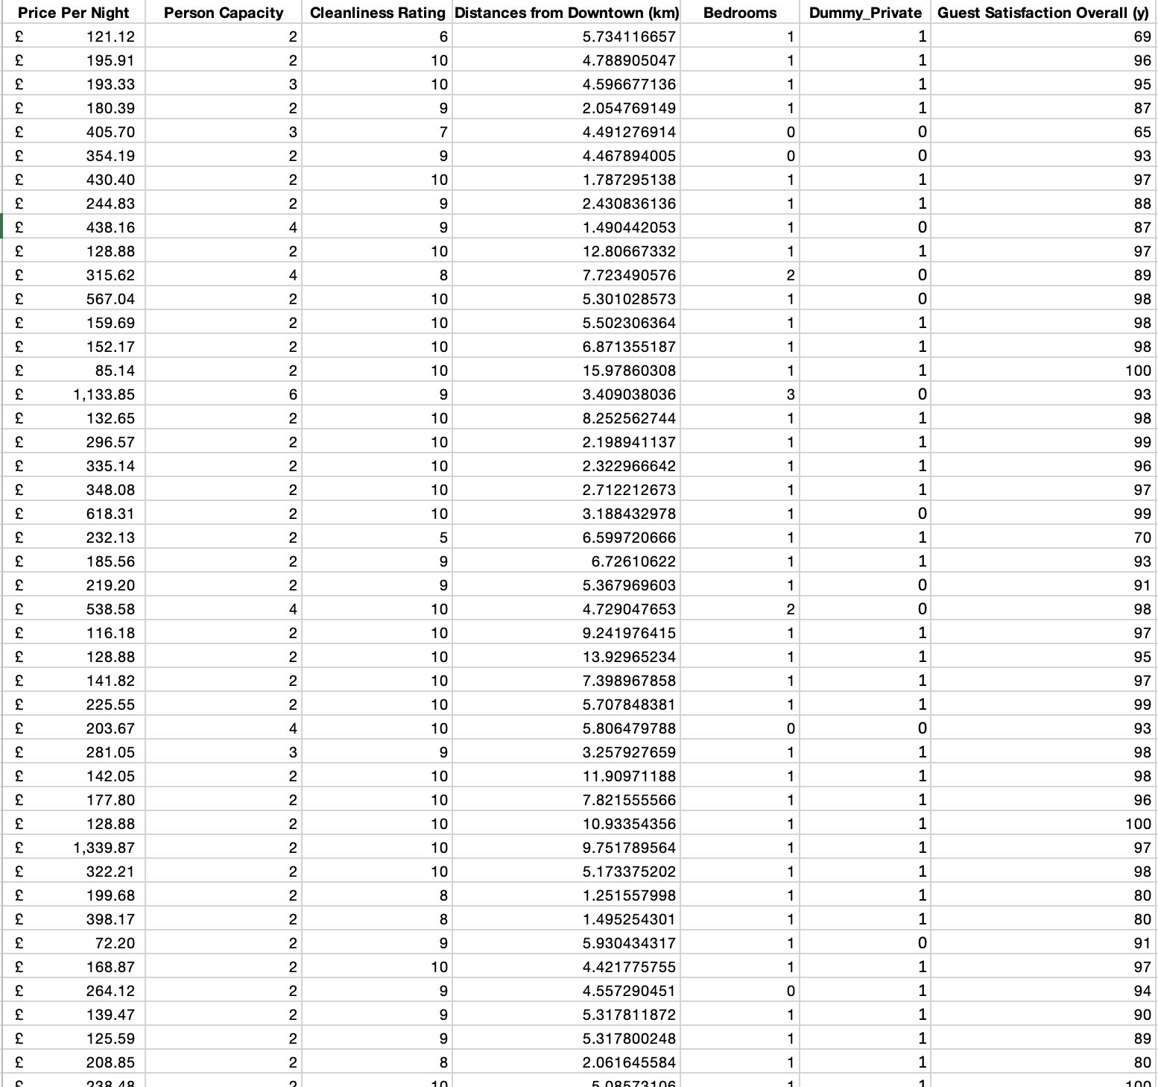
Data Preparation
Downloaded excel file
Changed column titles and moved variables for readability
Removed unnecessary data
We chose 6 variables we thought would have the biggest impact on guest overall satisfaction and removed the rest.
Created dummy variable
Converted the privacy status variable to a dummy variable with 0 representing that the room is shared and 1 representing that the room is private.
Notes:
To prepare the data, we downloaded the file from Kaggle and changed the labels to names that were easier to read. Next, we chose 6 variables that we thought would have the biggest impact on a guest’s overall satisfaction and removed the rest of the data. We also created a dummy variable for privacy status. In the original file, the data for this variable was as true or false, and we changed it to be represented by 1 or 0.

Slide 10
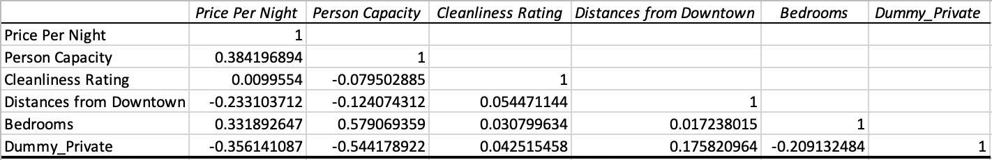
Method: Multicollinearity
Notes:
The first thing we did for our regression analysis is make a correlation matrix to test for multicollinearity between the independent variables. As you can see by the chart, all of the correlations between the independent variables are between the -0.7 and 0.7 thresholds, so there is no concern about correlation between the independent variables.

Slide 11
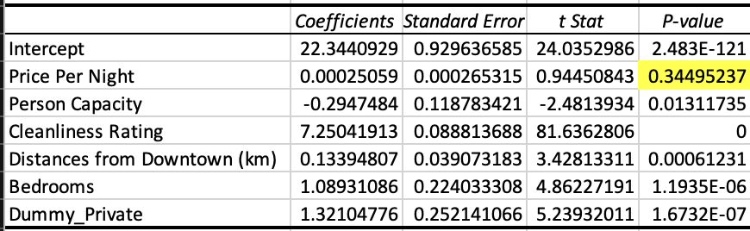
Method: Removing High P-Values
Notes:
Next, we focused on finding a parsimonious regression model. We found an estimated regression model and compared the p-values of the independent variables to the level of significance, which was 0.05. As shown in the chart, the only independent variable with a p-value greater than 0.05 was price per night, which had a p-value of about 0.345. We removed this variable and re-ran the regression, which got us the parsimonious model. One interesting finding is that the p-value for the cleanliness rating variable is 0. This likely means the cleanliness rating always has an effect on the overall satisfaction of a guest since a p-value of 0 shows that the variable is very statistically significant.

Slide 12
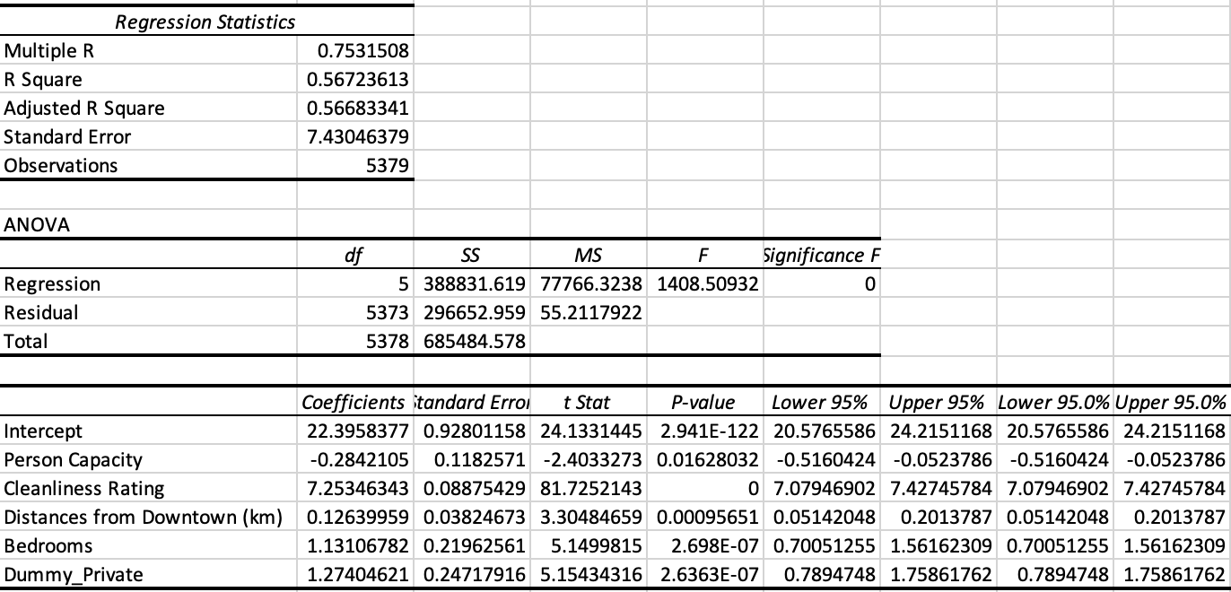
Final Regression
Notes:
This is the parsimonious model. Since all of the p-values for the independent variables are less than our alpha of 0.05, we can reject our null hypothesis that the coefficients of the independent variables equal zero, and therefore we can conclude that the independent variables in our model do have an impact on the overall satisfaction of an Airbnb guest. Looking at our coefficient of determination, r^2, we can see that about 56.72% of a guest's overall satisfaction in our sample can be explained by the linear relationship between the independent variables included in the model and the dependent variable, guest overall satisfaction.

Slide 13
Residual Plots
Notes:
My name is Christian Kleronomos and I will be going over the residual plots, final model and the conclusion. We are going to start by looking at the residual plots. Using the p-values, correlation matrix, and looking at the residual plots themselves, we can conclude that they meet the conditions for valid inference. All of the residual plots can be captured using a linear model, the residuals have a mean of 0, are statistically independent, and have constant variance. Because of this, we do not see any limitations based on our residual plots.

Slide 14
Final Model
Guest Satisfaction of a London Airbnb on a weekend= 22.40 - 0.28(A) + 7.25(B) + 0.13(C) +1.13(D) + 1.27(E)
C= Distance from Downtown (km)
D= Number of Bedrooms
A= Person capacity per room
B= Cleanliness Rating
E= Dummy_Private
Notes:
This is our final parsimonious model of overall guest satisfaction of a London Airbnb on a weekend. If all of the independent variables were 0, guest satisfaction would be at a 22 out of 100. Additionally, a one person increase in capacity would have us expect a decrease in satisfaction by .28 holding all other variables constant. Following the same idea of holding all other variables constant, every increase in cleanliness rating, on a scale of 1-10, would make us expect an increase in satisfaction by 7.25. For every 1 kilometer further the Airbnb was from downtown London, guest satisfaction would be expected to increase by .13 with all other variables held constant. For every 1 additional bedroom the guests had access to, there would be an expected increase of 1.13 in guest satisfaction while all other variables remain constant. Finally, if the Airbnb was Private as opposed to shared, there we would expect an increase of 1.27 in guest satisfaction.

Slide 15
Conclusion
We started with 6 independent variables: Price per night (in Pounds), Person Capacity, Cleanliness Rating, Distance from Downtown (in kilometers), Bedrooms, and a dummy variable representing if a room was private or shared.
By the time we reached our parsimonious model, we removed 1 variable: Price per night.
We ended up at our parsimonious model with only the most statistically significant variables remaining. The coefficient of determination ended up being 0.5672 which is on the lower side. This tells us that only 56.72% of the variation in guest satisfaction is explained by our independent variables
Notes:
With our starting data, we chose 6 of the variables to predict guest satisfaction of an Airbnb in London on a weekend. Price per night, person capacity, cleanliness rating, distance from downtown, bedrooms, and a created dummy variable for the privacy of the room. We used regression analysis to find the P-value of the price per night was over our alpha of .05, so we eliminated the variable as it is not statistically significant. We then did another regression analysis where we found that all our p-values were below our alpha of .05. This was then recognized as our parsimonious model with capacity, cleanliness rating, distance from downtown, number of bedrooms, and our dummy private variable remaining. The coefficient of determination was on the lower side being only .5672 which shows us that only 56.72% of the variation in guest satisfaction is explained by the independent variables.

Slide 16
Conclusion (Continued)
In the parsimonious model, the variable that is the most significant is the Cleanliness rating. The data suggests that as the cleanliness rating goes up by 1 point, there is an increase of 7.25 ‘score’ in overall guest satisfaction.
For the parsimonious model, the least significant variable is the distance from downtown (in kilometers). While it is still a positive coefficient, it has the least effect on the overall guest satisfaction. The data suggests that a one-kilometer increase in distance from downtown will raise a guest satisfaction ‘score’ by 0.13.
Notes:
To conclude our presentation, we would like to talk about the most and least significant variables in our parsimonious model. The most significant variable was the cleanliness rating as every one point increase in cleanliness leads us to expect an increase of 7.25 in the guest rating, which is the largest change that a variable can cause in our model. The least significant variable is the distance from downtown. If there was a 1 kilometer increase in distance from downtown London, we would only expect an increase of .13 in guest satisfaction. This variable has the least impact compared to the rest of the variables as every one unit increase in distance from downtown is expected to yield the least change

Slide 17
Work Cited
“Airbnb Prices in European Cities.” Kaggle: Your Machine Learning and
Data Science Community, 2023, https://www.kaggle.com/datasets/thedevastator/airbnb-prices-in-european-cities?select=london_weekends.csv.
Dataset:
https://iowa-my.sharepoint.com/:x:/r/personal/rkmcdermott_uiowa_edu/_layouts/15/doc2.aspx?sourcedoc=%7BB1CA933D-8CFA-401F-AE75-B00583E04DCD%7D&file=Business%20Analytics%20Project.xlsx&action=default&mobileredirect=true&DefaultItemOpen=1&ct=1682992411131&w
Notes:
Thank you for listening to our presentation on guest satisfaction in London Airbnb's on a weekend. Here are our links for the Kaggle dataset and our excel workbook

